Slide 1
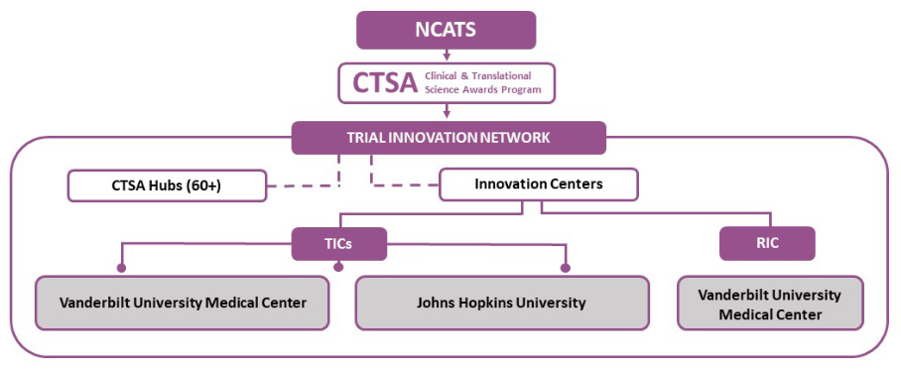
TIN Overview & Getting Started
A guide for investigators
The Trial Innovation Network (TIN) is a collaborative partnership with Investigators at the 60+ hubs in the national CTSA network. The vision of the TIN is to innovatively address critical roadblocks in multi-site clinical research and accelerate the translation of novel interventions into life-saving therapies.
What is the Trial Innovation Network?
The TIN focuses on operational innovation, operational excellence and collaboration, and will leverage the expertise and resources of the CTSA Program. There are two ways to get involved in the TIN:
The local TIN Liaison Team will connect investigators with multi-site clinical trials initiated by other network sites.
Investigators can submit their own proposals for multi-site trials to the TIN; the next page outlines how to submit.
Three reasons why you should partner with the TIN
1
Operational Innovation
The TIN provides expert methodological and logistical guidance and draws on evidence-based strategies for success, which allows you to focus on the science.
Excellence
The TIN helps to improve the multi-center study process by leveraging the national CTSA network and taking advantage of established infrastructure.
Collaboration
The TIN connects you and your team with relevant experts, works in partnership with other NIH Institutes and Centers, and provides access to the entire CTSA network.
2
3
The Trial Innovation Network is comprised of three Trial Innovation Centers,
one Recruitment Innovation Center, and 60+ CTSA Hubs
Trial Innovation Centers
The two Trial Innovation Centers (TICs) are managed by Vanderbilt and Johns Hopkins Universities. They provide support in the following areas:
Protocol development
Study operations enhancement
Trial budgeting guidance
Regulatory agreements
Data coordination & management
Data safety & monitoring
Recruitment Innovation Center
The Recruitment Innovation Center (RIC) is managed at Vanderbilt and is an evidence-based center in innovative trial recruitment and retention methods, tools, and strategies. The RIC provides support with:
Community engagement studios
Recruitment planning and feasibility assessment
Recruitment materials
EHR-based tools & resources
Site identification
Learn more about the TIN @ www.trialinnovationnetwork.org

Slide 2
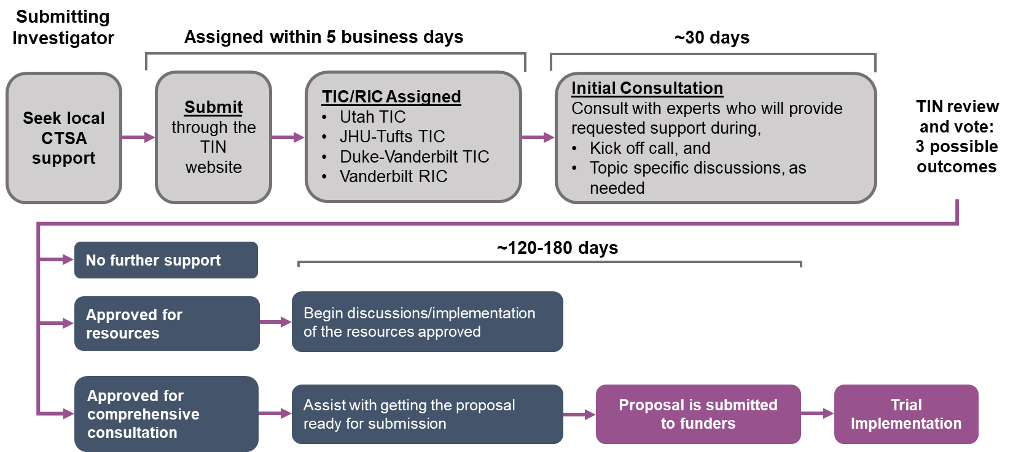
Getting Started with the TIN
at [INSTITUTION NAME HERE]
What makes a good TIN submission?
A multi-site clinical trial design (3+ institutions)
Potential to demonstrate an innovative operational approach
Opportunity to foster broad collaboration across the CTSA and NIH Institutes and Centers
Includes all populations affected by the health condition being studied
Time needed to collaborate prior to grant submission
60 days to 180+ days, dependent on the level of support needed
How do I submit a proposal to the TIN?
1
Connect with your CTSA TIN Liaison Team Point of Contact
Your liaison will connect you with local CTSA resources and resources from the TICs and RIC.
Discuss your Project with Local CTSA Leadership
Your liaison will help arrange a meeting with the local CTSA leadership to review your project.
2
3
Work with the Point of Contact to Submit the TIN Online Application
Within 5 business days from submission, you will be assigned to a TIC and/or RIC to arrange an initial consultation at no cost.
NUCATS.NORTHWESTERN.EDU
CTSA Liaison Team Point of Contact
Toddie (Patricia) Hays, MPA, PMP
patricia.hays@northwestern.edu
What happens after my TIN submission?
Start
Here
All applicants will receive an initial consultation. If applications require additional resources, an implementation plan will be developed for the approved resources. If a comprehensive consultation is needed, collaborative guidance for proposal development will be provided before submitting to funders.
Learn more about the TIN @ www.trialinnovationnetwork.org

